Slide 1
Introduction to React
Author: Hoyden L’Heureux

Slide 2

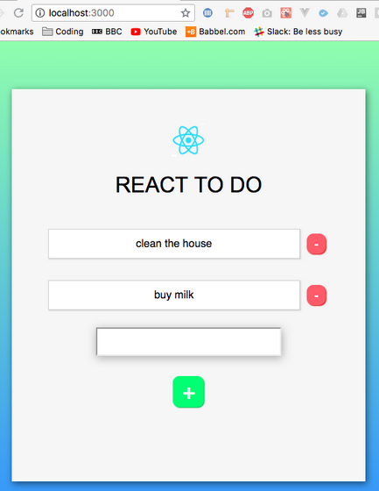
What is react?
An efficient and flexible JavaScript Library
Makes complex user interfaces
The View of the Model View Controller (MVC)
Composed of small blocks of code called “components”

Slide 3
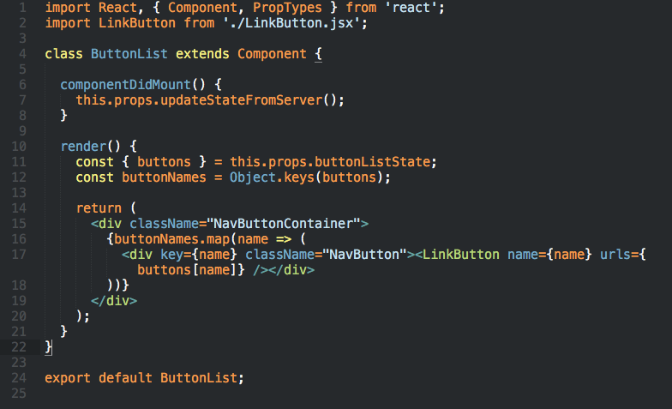
Why use Reactjs?
Declarative language
Reusable components
Easy to learn and use

Slide 4
Examples of sites built with react
Facebook
Producthunt
Messenger.com
Instagram

Slide 5
What makes reactjs?
Reactjs is made with JSX which is JavaScript and XML combined
Uses all standard HTML attributes
Some syntax changes (className instead of just class)

Slide 6
Virtual dom
ReactJs uses a virtual DOM (Document Object Model)
This allows for faster refreshing of the page with changes that are made

Slide 7
3 important parts of react
Components – everything is a component in React
Props
States

Slide 8
What does a component do?
A component is what tells the React what to show on the screen
Changes with the data that is entered into the components and redisplayed
Can take in parameters (a.k.a props) – then returns a hierarchy
Created with the syntax – React.createClass

Slide 9
Component key functions
getInitialState : function() {}
componentWillMount : function() {}
componentDidMount : function() {}
componentDidUnmount : function() {}
render : function() {}

Slide 10
props
Are attributes for components
Used for unidirectional data flow
Read-only (immutable)

Slide 11
states
Defined within the component
Tells the component when to re-render

Slide 12
State key functions
getInitialState() – sets the initial state/value of a component
setState({state: value}) – used to update the state

Slide 13
Viewing data
The code is written in the render function
Is used to read states and props, but returns JSX elements
Syntax
render: function() {
return (
<div className = “classDescription”>{this.props.value}</div>
);
}

Slide 14
events
There are many events that can happen within an app handled similar to DOM as usual
A small selection of these are:
onClick
onMouseLeave
onMouseMove
onDragOver
onContextMenu
… and many more

Slide 15
Component lifecycle
This is important to remember for error handling and deciding where and when to place components
Can be over ridden to run your code at different times
First Render
getDefaultProps
getInitialState
componentWillMount
Render
componentDidMount

Slide 16
Resources
Reactjs.org – explanations and some tutorials
Node.js – where to download Node.js to run your apps locally

Slide 17


questions

